Slide 1

Building an anime recommendation system using Machine Learning

Slide 3



Introduction
Anime recommendation systems are software programs designed to suggest anime shows or movies to users based on their preferences. These systems employ machine learning algorithms that analyze user behavior, viewing history, ratings, and other relevant data to make personalized recommendations.
GOALS
CHALLENGES
The goal of an anime recommendation system is to help users discover new anime shows and movies that they may be interested in but may not have found on their own. By providing tailored recommendations, these systems can increase user engagement and satisfaction, leading to improved retention rates for streaming platforms and increased revenue.
One of the key challenges in building an effective anime recommendation system is dealing with the high level of subjectivity and variability in user preferences. Different viewers may have vastly different tastes in anime, and some users may enjoy niche genres or subgenres that are not as widely popular. Additionally, there may be significant cultural and language barriers for users who watch anime produced in Japan and distributed with subtitles or dubs.

Slide 4
Introduction
Anime recommendation systems are software programs designed to suggest anime shows or movies to users based on their preferences. These systems employ machine learning algorithms that analyze user behavior, viewing history, ratings, and other relevant data to make personalized recommendations.
GOALS
CHALLENGES
The goal of an anime recommendation system is to help users discover new anime shows and movies that they may be interested in but may not have found on their own. By providing tailored recommendations, these systems can increase user engagement and satisfaction, leading to improved retention rates for streaming platforms and increased revenue.
One of the key challenges in building an effective anime recommendation system is dealing with the high level of subjectivity and variability in user preferences. Different viewers may have vastly different tastes in anime, and some users may enjoy niche genres or subgenres that are not as widely popular. Additionally, there may be significant cultural and language barriers for users who watch anime produced in Japan and distributed with subtitles or dubs.

Slide 5
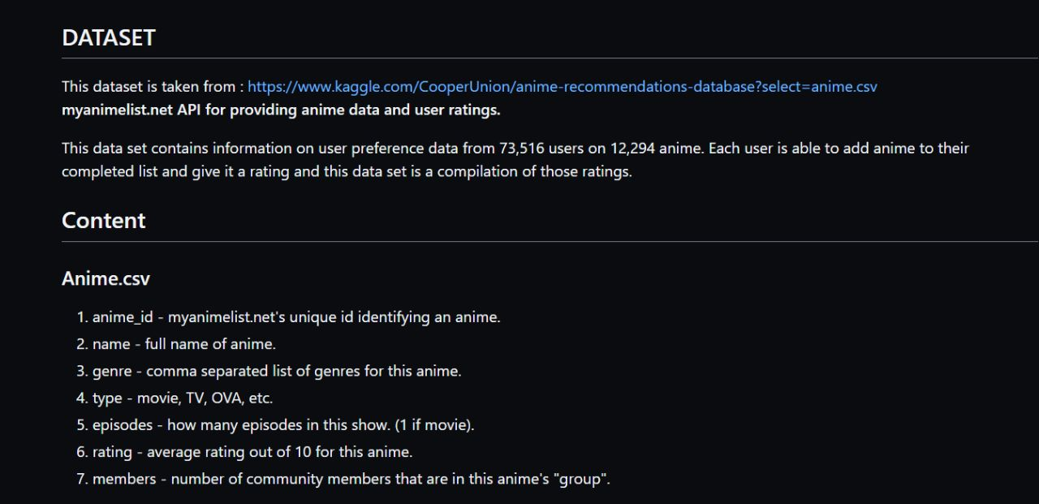

STOP LOOKING HERE

Slide 6
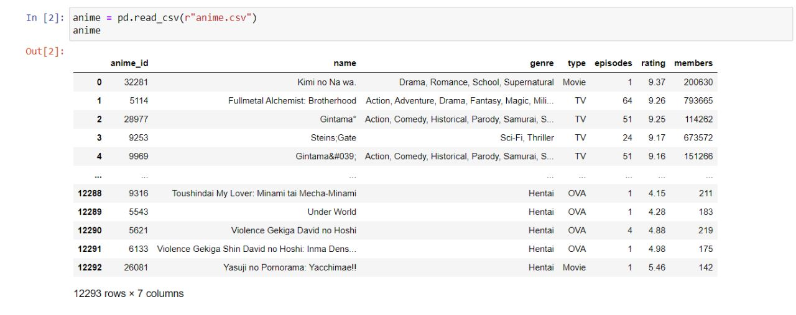

Slide 7
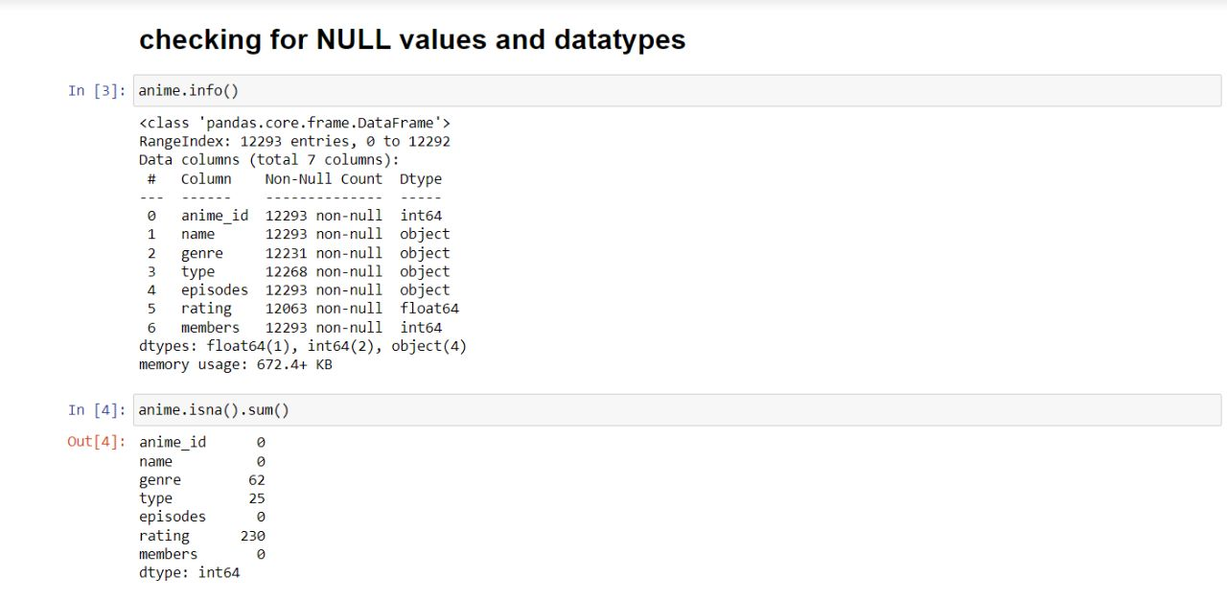

Slide 8
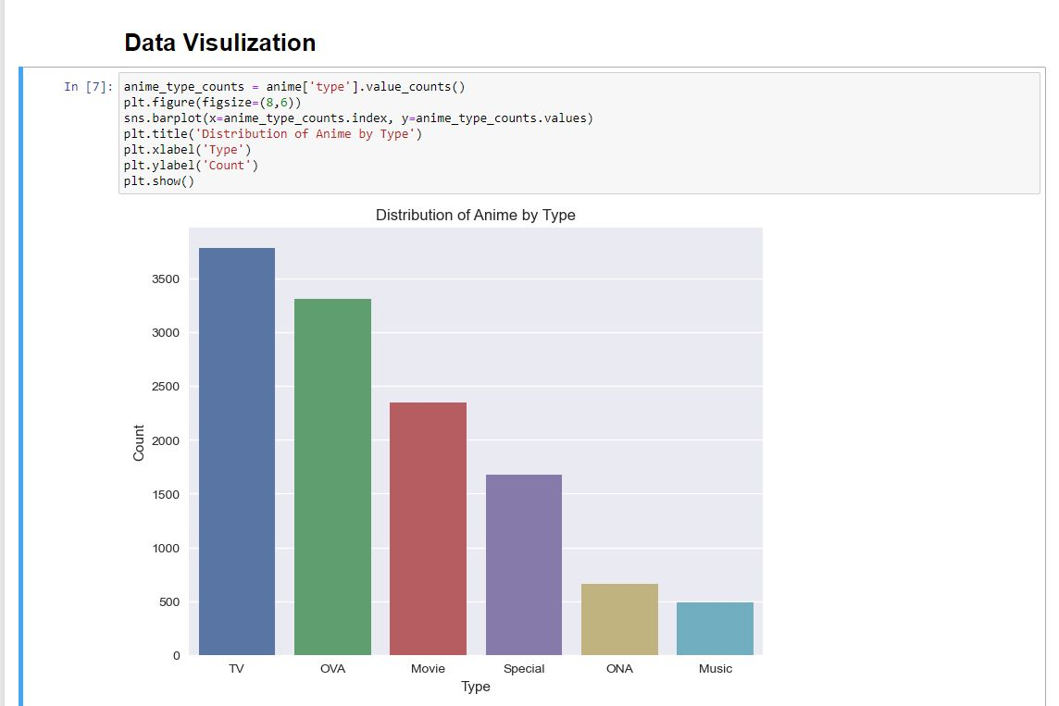

Slide 9

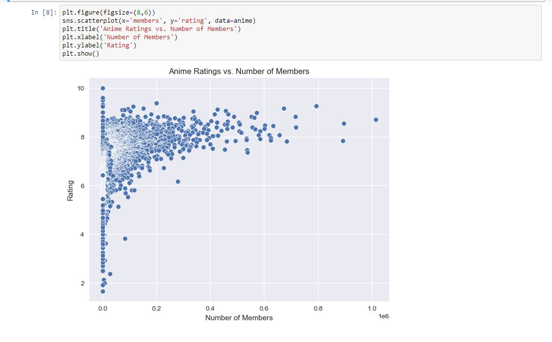


Slide 10

K-Nearest Neighbors (KNN) is a type of supervised machine learning algorithm used for classification and regression tasks. In the context of a recommendation system, KNN can be used for collaborative filtering, which is a popular method for making personalized recommendations based on the similarity between users or items.
Details about the model used

Slide 11
KNN works by identifying the k-nearest neighbors of a given data point based on a similarity metric, such as Euclidean distance or cosine similarity. For example, in a user-based collaborative filtering approach, the similarity between users can be calculated based on their ratings for different items. Given a target user and an item that they have not yet rated, the KNN algorithm can identify the k-most similar users to the target user and use their ratings for the item to predict the rating that the target user would give.
K-Nearest Neighbors (KNN) is a type of supervised machine learning algorithm used for classification and regression tasks. In the context of a recommendation system, KNN can be used for collaborative filtering, which is a popular method for making personalized recommendations based on the similarity between users or items.
Details about the model used

Slide 12
KNN works by identifying the k-nearest neighbors of a given data point based on a similarity metric, such as Euclidean distance or cosine similarity. For example, in a user-based collaborative filtering approach, the similarity between users can be calculated based on their ratings for different items. Given a target user and an item that they have not yet rated, the KNN algorithm can identify the k-most similar users to the target user and use their ratings for the item to predict the rating that the target user would give.
K-Nearest Neighbors (KNN) is a type of supervised machine learning algorithm used for classification and regression tasks. In the context of a recommendation system, KNN can be used for collaborative filtering, which is a popular method for making personalized recommendations based on the similarity between users or items.
One of the advantages of KNN is that it is a non-parametric algorithm, meaning that it does not make any assumptions about the distribution of the data. This makes it useful for handling complex, non-linear relationships between variables. However, KNN can be computationally expensive, particularly as the size of the dataset increases.
Details about the model used

Slide 13
KNN works by identifying the k-nearest neighbors of a given data point based on a similarity metric, such as Euclidean distance or cosine similarity. For example, in a user-based collaborative filtering approach, the similarity between users can be calculated based on their ratings for different items. Given a target user and an item that they have not yet rated, the KNN algorithm can identify the k-most similar users to the target user and use their ratings for the item to predict the rating that the target user would give.
K-Nearest Neighbors (KNN) is a type of supervised machine learning algorithm used for classification and regression tasks. In the context of a recommendation system, KNN can be used for collaborative filtering, which is a popular method for making personalized recommendations based on the similarity between users or items.
One of the advantages of KNN is that it is a non-parametric algorithm, meaning that it does not make any assumptions about the distribution of the data. This makes it useful for handling complex, non-linear relationships between variables. However, KNN can be computationally expensive, particularly as the size of the dataset increases.
In the context of a recommendation system, KNN can be used in both user-based and item-based collaborative filtering approaches. It can also be used in combination with other techniques, such as matrix factorization, to improve the accuracy of the recommendations.

Slide 14
KNN works by identifying the k-nearest neighbors of a given data point based on a similarity metric, such as Euclidean distance or cosine similarity. For example, in a user-based collaborative filtering approach, the similarity between users can be calculated based on their ratings for different items. Given a target user and an item that they have not yet rated, the KNN algorithm can identify the k-most similar users to the target user and use their ratings for the item to predict the rating that the target user would give.
One of the advantages of KNN is that it is a non-parametric algorithm, meaning that it does not make any assumptions about the distribution of the data. This makes it useful for handling complex, non-linear relationships between variables. However, KNN can be computationally expensive, particularly as the size of the dataset increases.
In the context of a recommendation system, KNN can be used in both user-based and item-based collaborative filtering approaches. It can also be used in combination with other techniques, such as matrix factorization, to improve the accuracy of the recommendations.

Slide 15
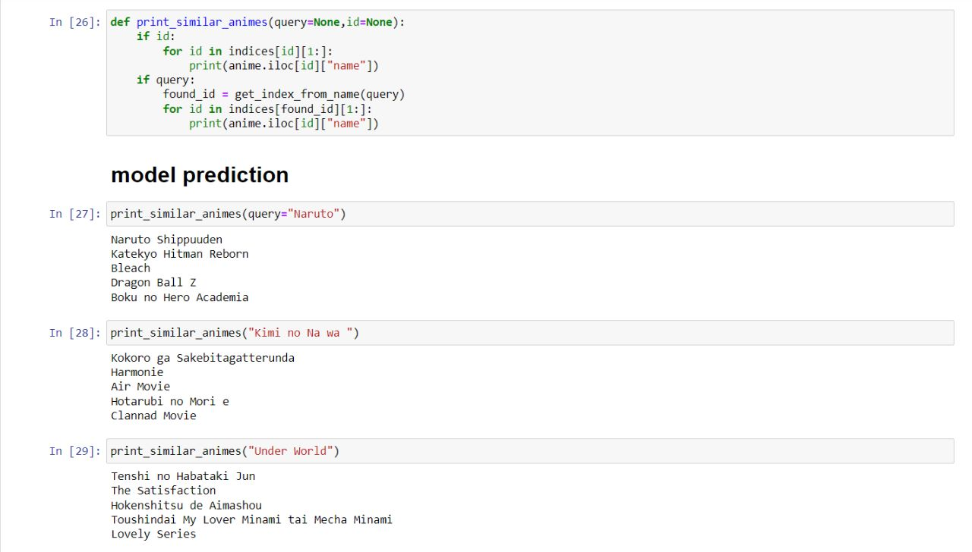

Slide 16

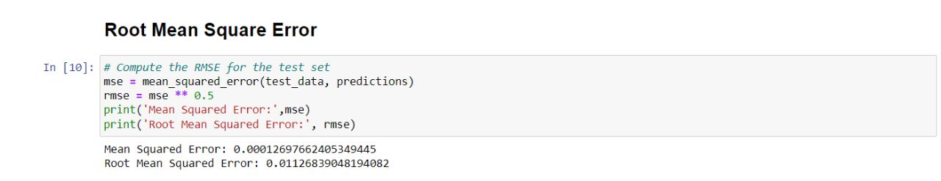

Slide 17

THANK YOU

